Slide 1
Wind Energy in the US
By Andrey Uuemaa

Slide 2
Data Sources
https://eerscmap.usgs.gov/uswtdb/ - the US Wind Turbine Database
60,000+ Turbines, Land-based & Offshore
Locations, Project Info, Technical Specs
https://www.nrel.gov/wind - the WIND Toolkit
Wind Speed, Net Capacity Factor and more
From 126,000 actual and hypothetical wind farms
Other Sources: individual projects costs, proximity to infrastructure

Slide 3
Motivation
Free Wind Energy resources available, but require:
Initial due diligence
Industry experience
My idea is to create a tool
Based on existing wind energy projects’ insights
Quick, initial snapshot recommendation on development in certain area
For wind energy developers; educational purposes

Slide 4
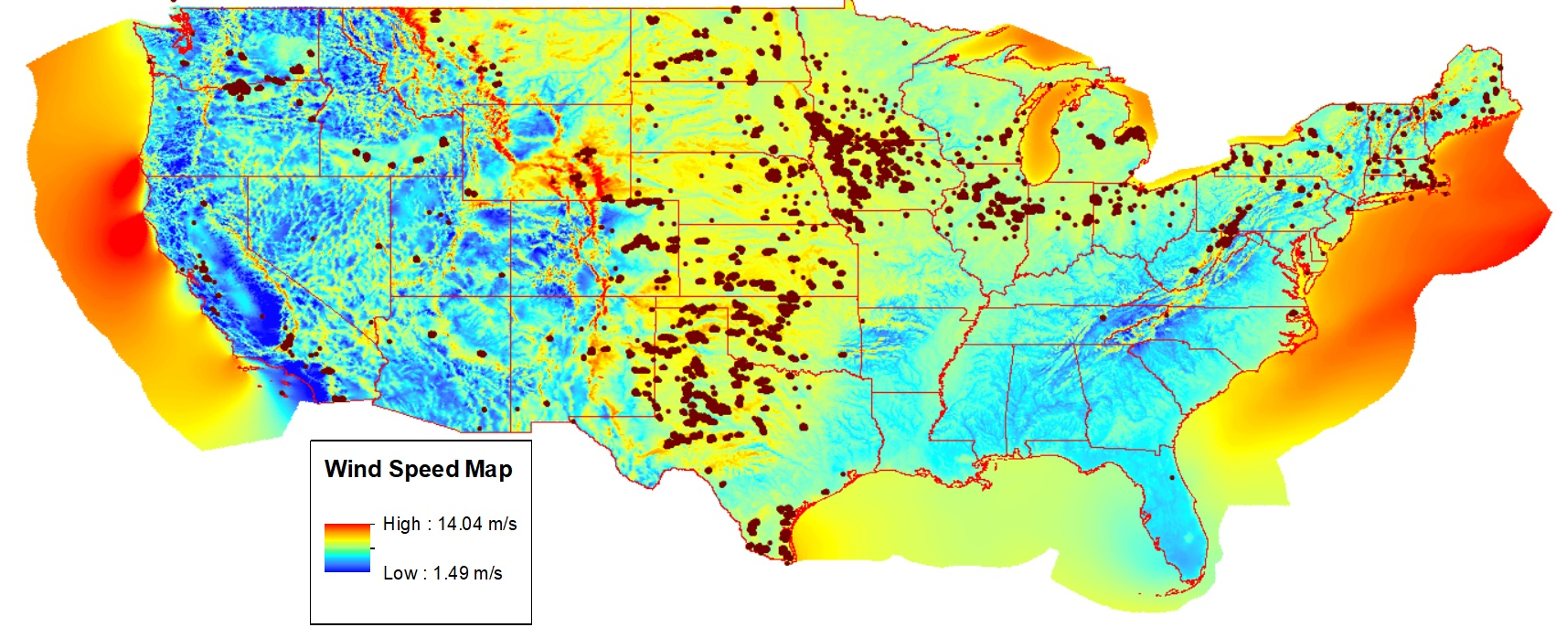
Initial Analysis: Turbines vs Wind Speed

Slide 5
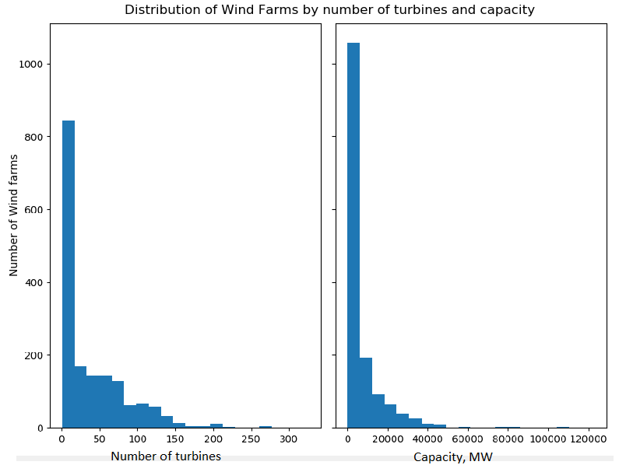
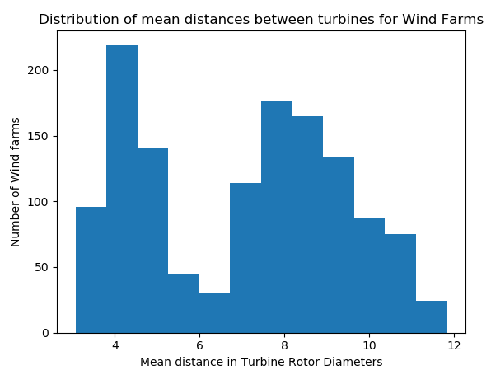
Initial Analysis: Zoom into Wind Farms

Slide 6
Farther Analysis & Goals
Study the layout of the wind farms relative to prevailing wind directions
Search for insights by clustering
Build a classifier to map future project location, budget, desired power capacity to recommendation on farm size and structure

